Slide 1
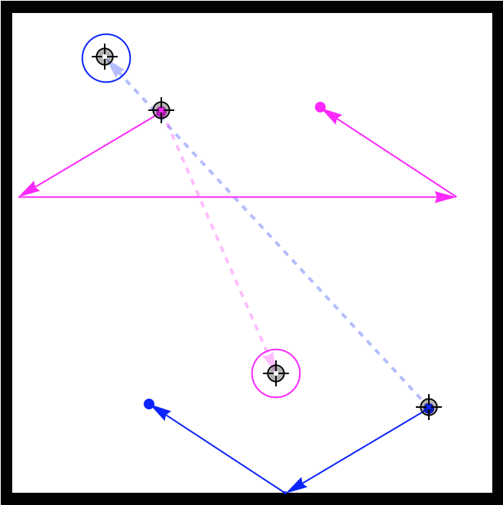
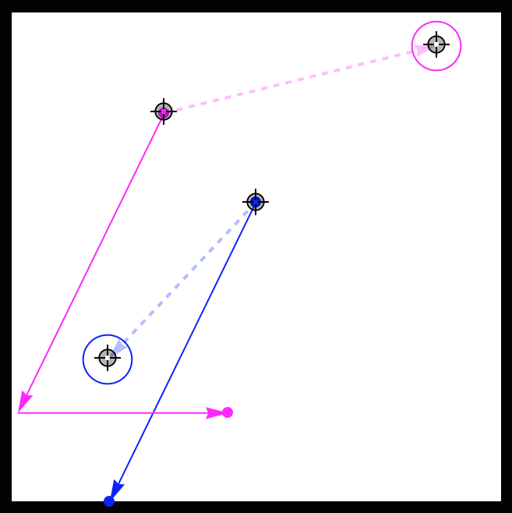
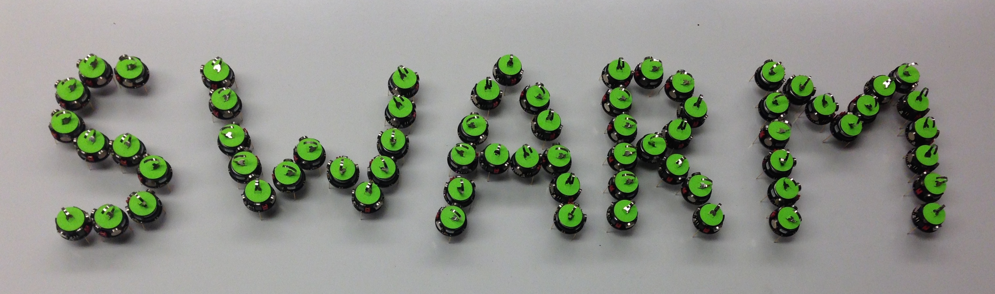




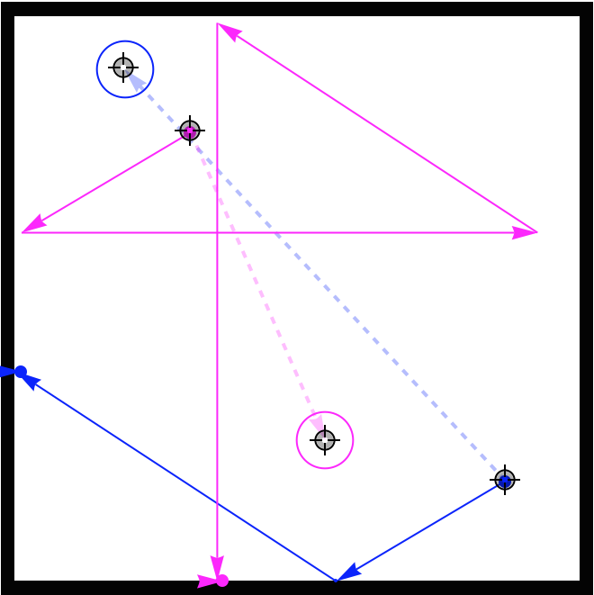
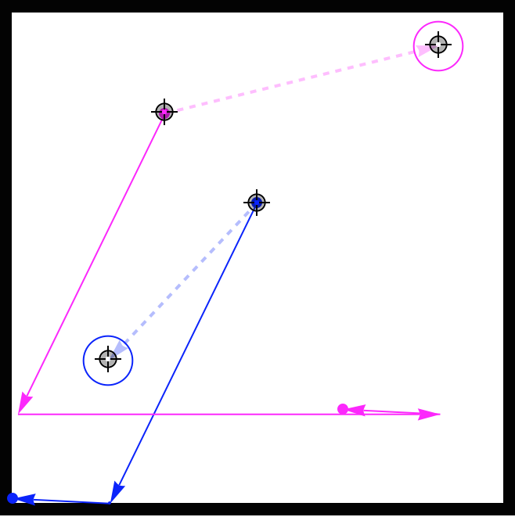
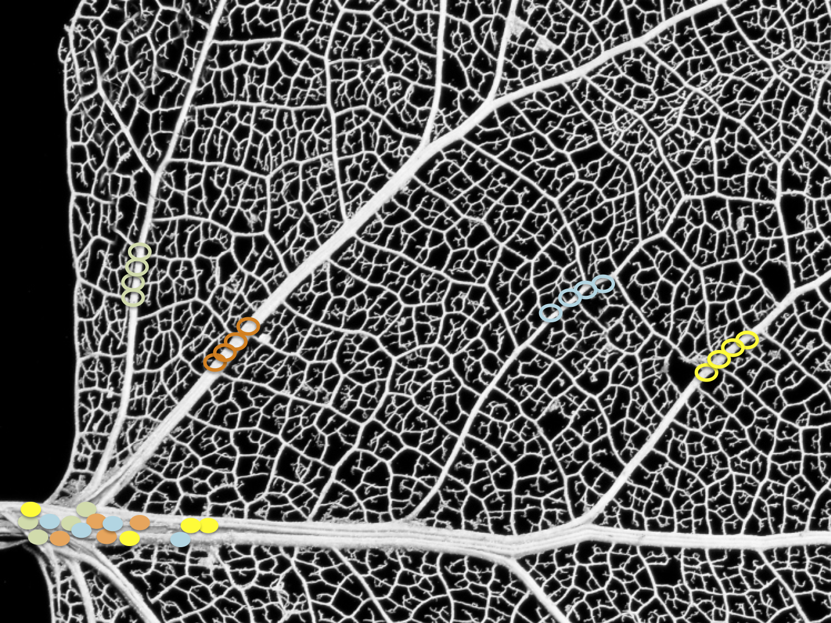
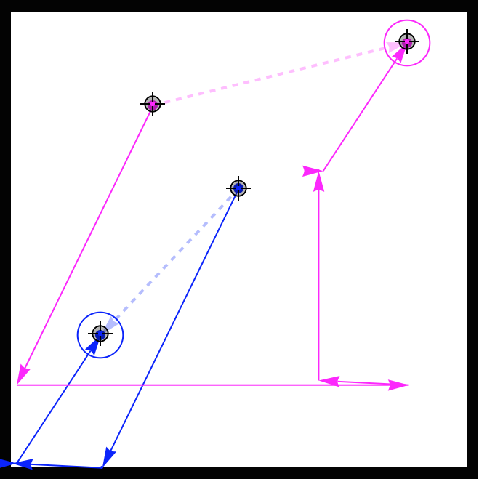
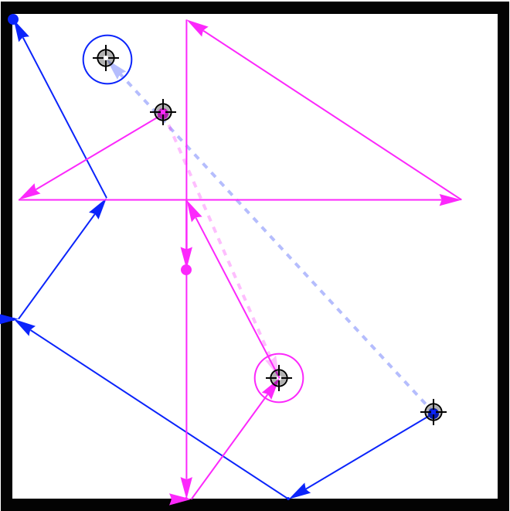
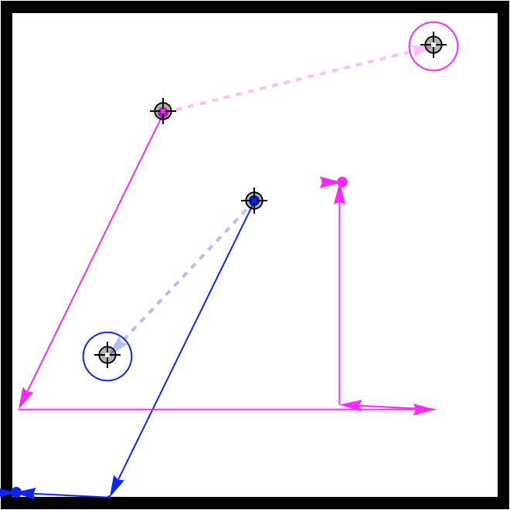
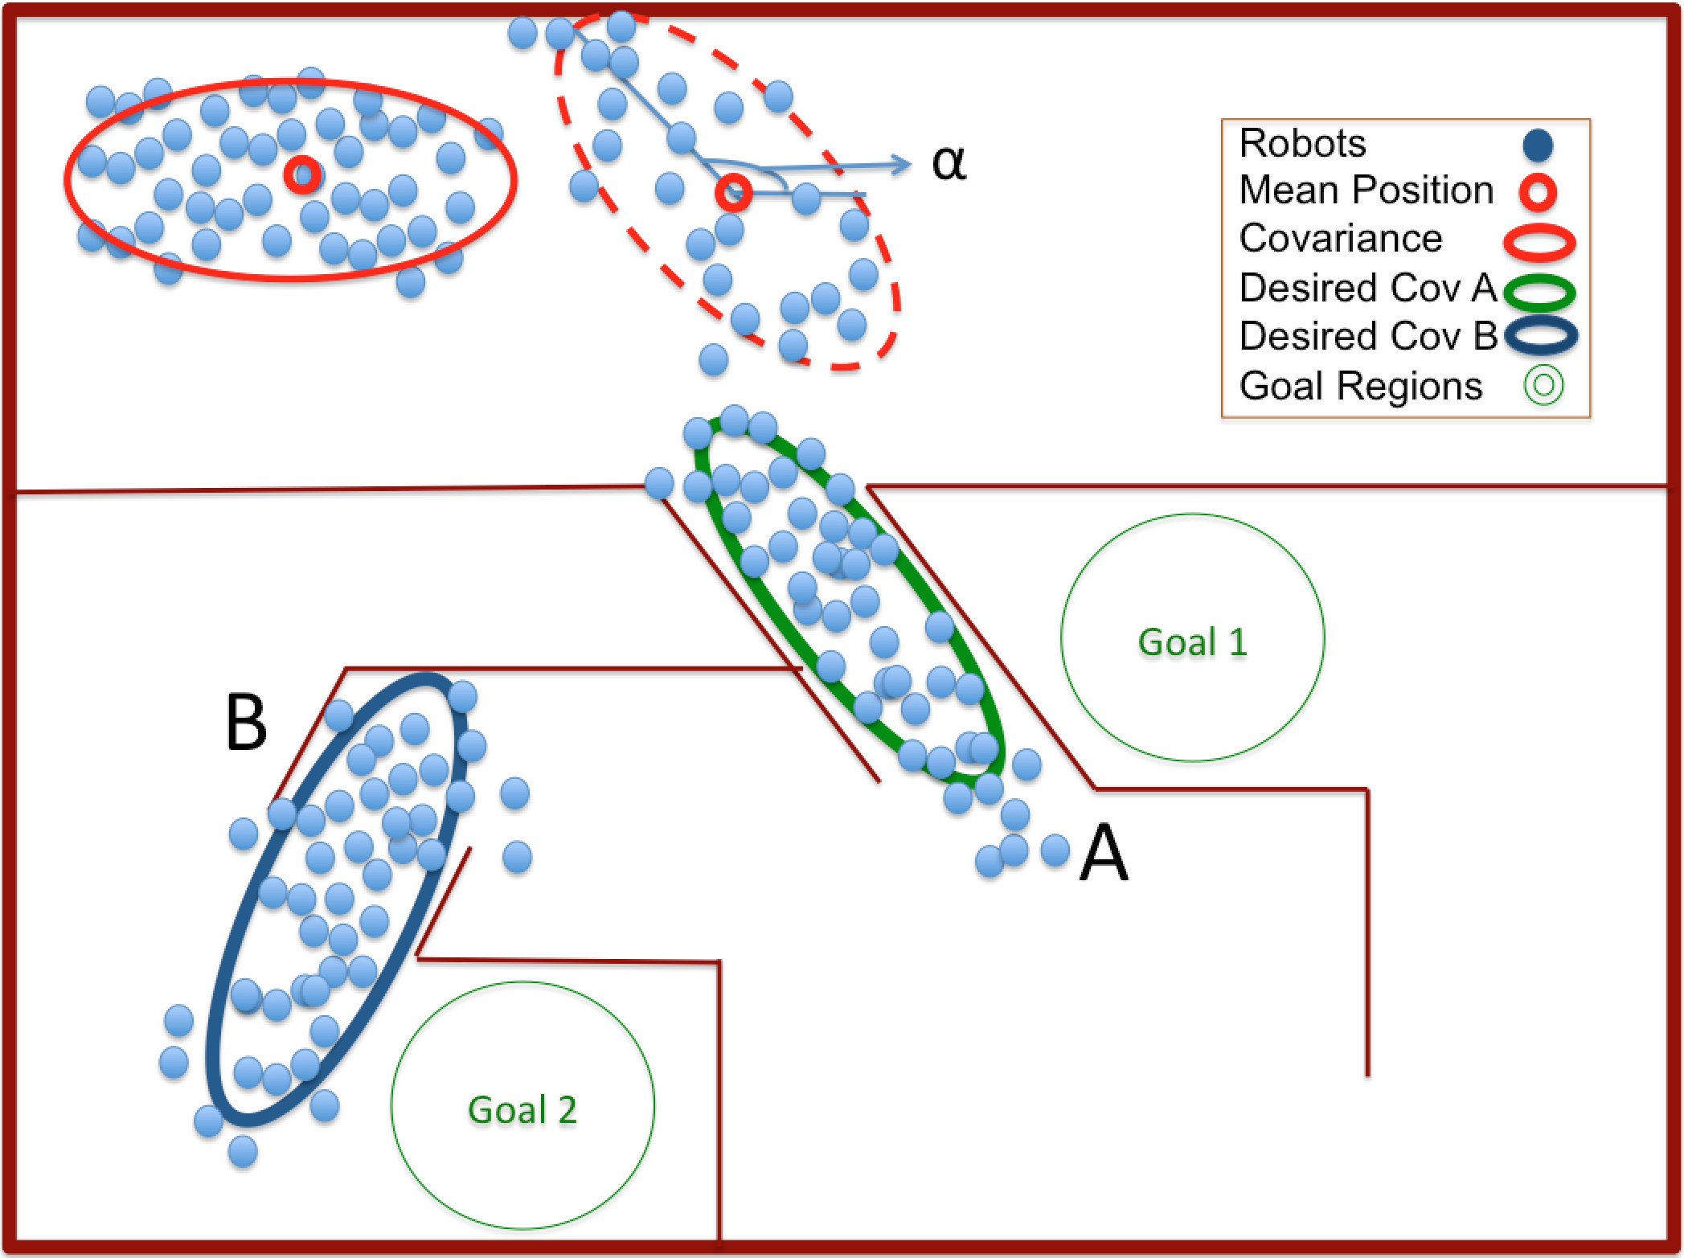
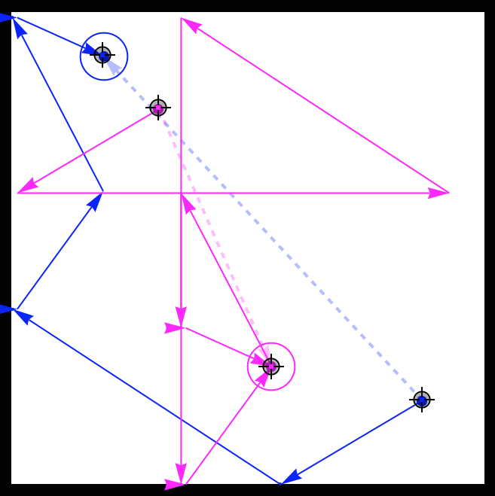
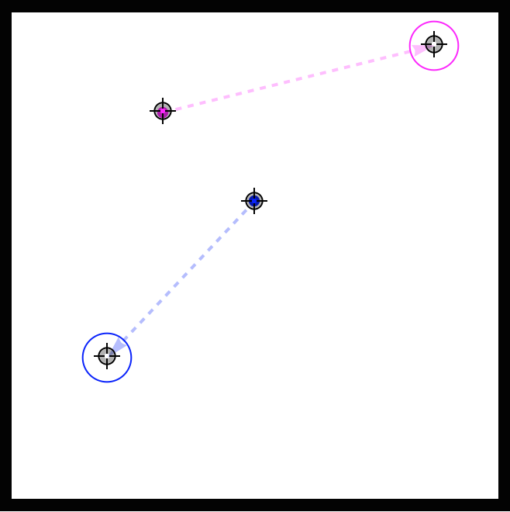
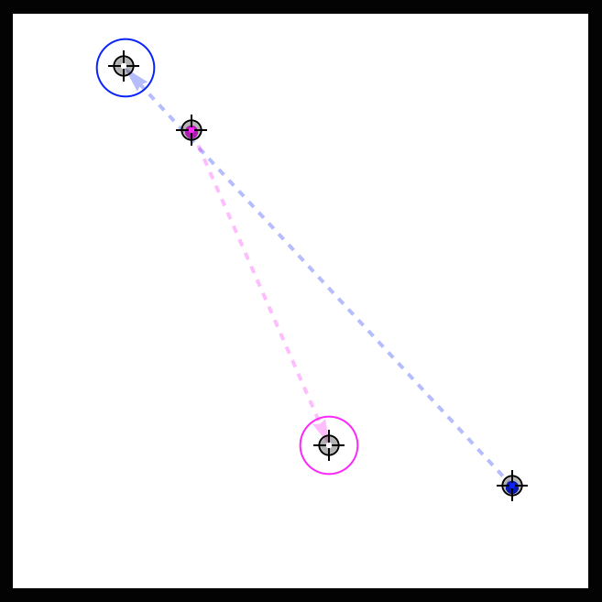
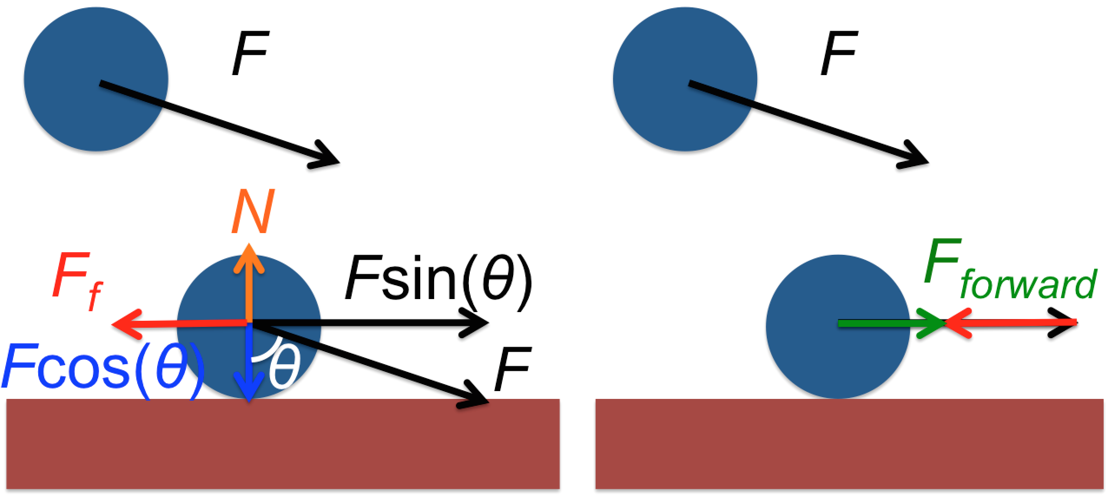
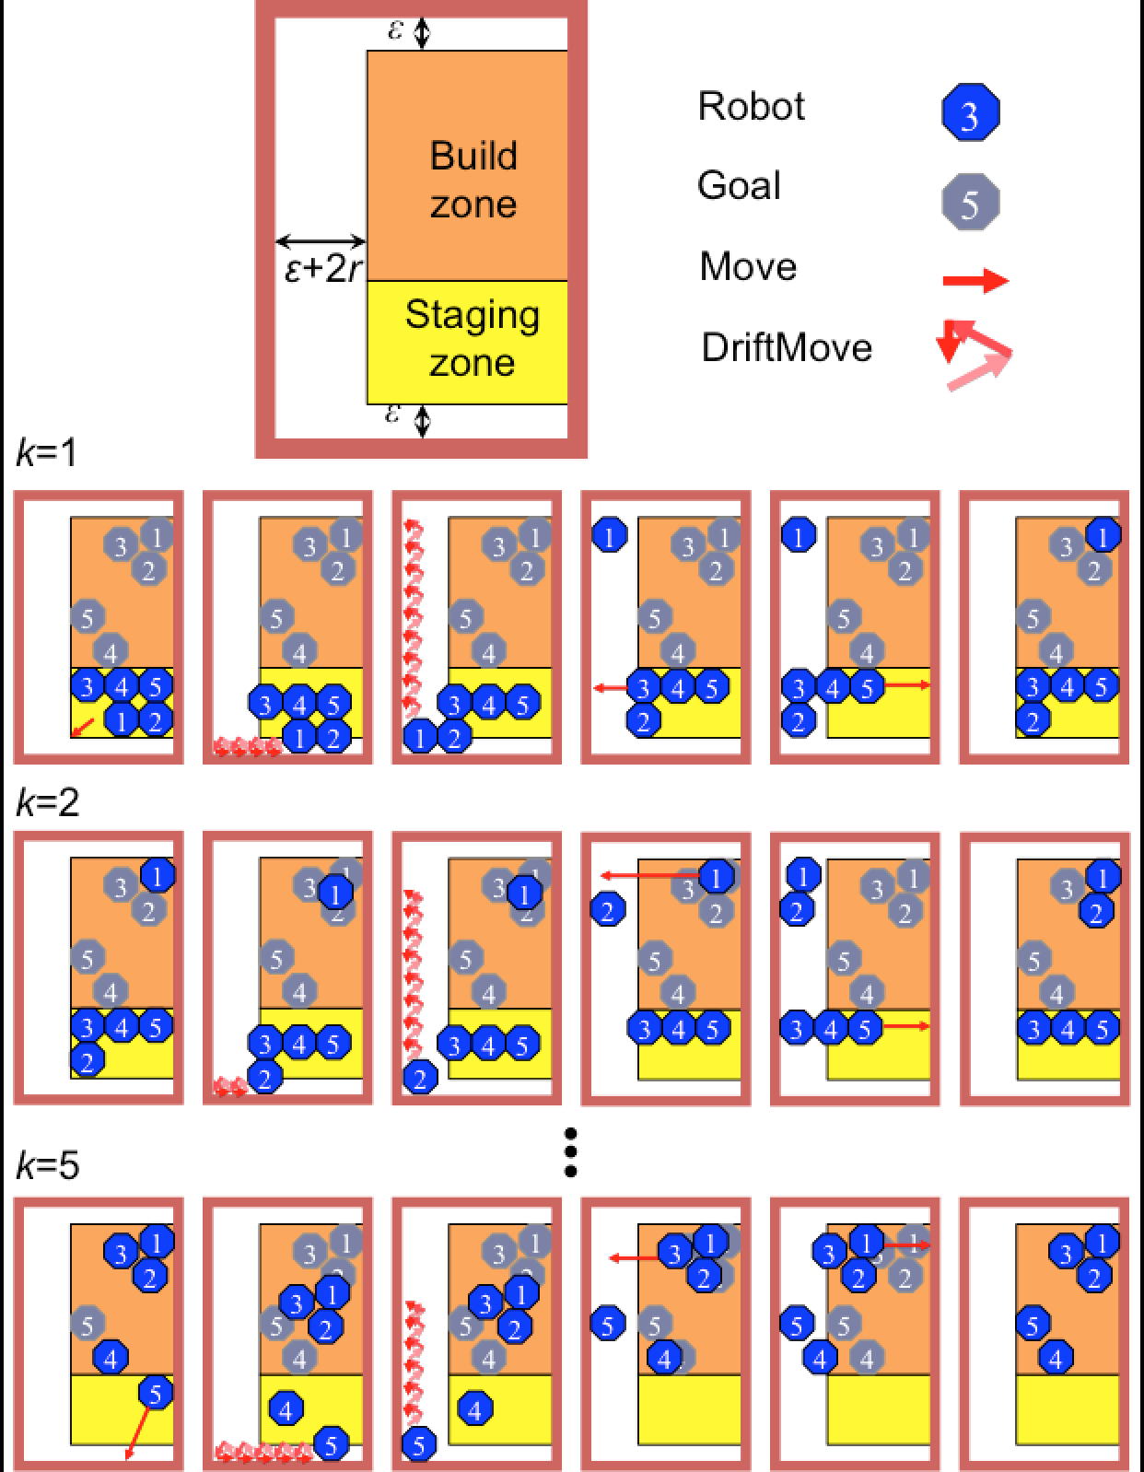
Shaping a Swarm Using Wall Friction and a Shared Control Input
Shiva Shahrokhi, Aaron T. Becker
sshahrokhi2@uh.edu, atbecker@uh.edu
Department of Electrical and Computer Engineering,
University of Houston
Website, C.V.
YouTube channel
Why Covariance Control?
Position Control using Wall Friction
Vascular networks are common in biology
Shared inputs means each member of the
swarm receives the same control input
Navigating a swarm using shared inputs
is challenging due to obstacles and
symmetry
We designed an algorithm for controlling the position of two robots
For simplicity, we assume that friction
is infinite
Following this path we can get to the ending points when getting the same input.
Maintaining group cohesion while steering a swarm through an arbitrary maze requires covariance control
Pushing swarm into vertical walls does not change x and y position correlation
We need to break this symmetry
Two robot positioning: switching positions using walls with infinite friction
Two robot positioning using hardware setup with two kilobot robots
Walls have nearly infinite friction
Robot with blue path is stopped by the wall until the light changes orientation
The orange robot in free-space is unhindered
Using Friction to Break Symmetry
Friction is sufficient to break the symmetry
Wall friction reduces forward force for robots near a wall, but not for free robots
Robot
Bottom Path
Top Path
Goal Positions
Multi Robot Control
We can extend this algorithm to control the position of n robots
Algorithm has n iterations
Iteration k assumes k-1 robots are at goal positions and moves kth robot to desired position
Results
Future Opportunities
We used kilobots to show that wall friction enables covariance control
Global Input: kilobots go to the brightest light source in the room
Plot shows covariance control is possible
Efficiently steer robot swarm through a maze
Use obstacles and wall friction to partition swarm
Implementing n robot position algorithm with kilobots
Solving position control algorithm with finite friction
Automatic covariance control law using wall friction

